Slide 1
Introduction to NoSQL
- Avinash Kumar

Slide 2
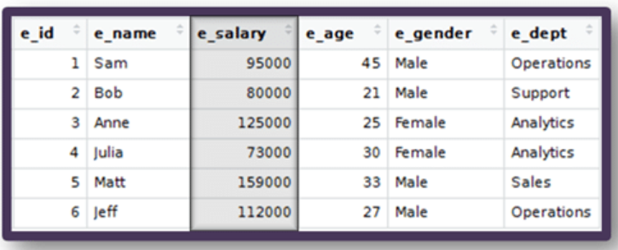
RDBMS
RDBMS: Relational Database Management System
Relational Databases persist data in tabular form structured to recognize relations between stored items of information.
DB2, MySQL, PostgreSQL, SQLite etc
Pros:
ACID
SQL - Structured Query Language
Strong consistency, concurrency and recovery.
Cons:
Not built to be distributed.
Joins are expensive
Hard to scale horizontally
Impedance mismatch

Slide 3
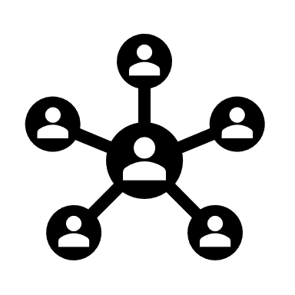



Case Analysis
Service with RDMS for data storage
ACID?
More read operations
Cache: Frequently executed query
More write operations
Vertical scaling
New Features, Caused DB complexity, lots of SQL joins
Denormalize data
Expand to other region
Need distributed approach

Slide 4
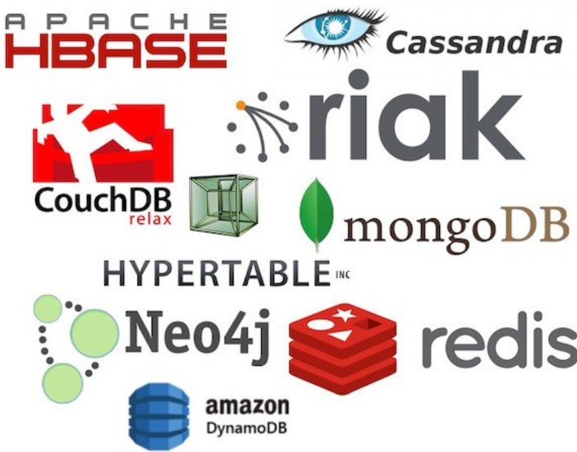
NoSQL
Cluster friendly
High availability and scalability
Schema less, non-tabular and non-relational
Big data capabilities
Avoids upfront schema design
Transactions are handled at application layer
Provides easy and frequent changes to db
Horizontal scaling
Fixes impedance mismatch
Allows faster development

Slide 5
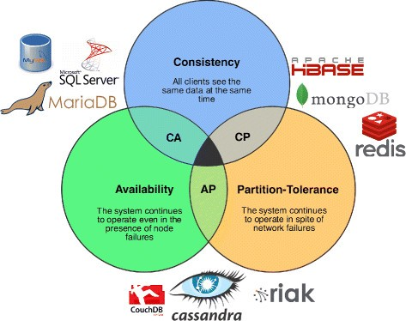
Cap Theorem
According to CAP theorem a distributed system can only provide at most 2 of these three properties
Consistency
Availability
Partition Tolerance
Node1
Node2

Slide 6
BASE
Basically available: Nodes in a distributed environment can go down but the whole system shouldn’t be affected.
Soft state (scalable): The state of the system and data could change over time.
Eventually consistency: Given enough time, data will be consistent across the distributed system.

Slide 7
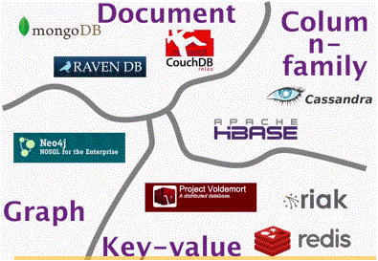
Aggregate Data Models
NoSQL databases are divided in four major data models:
Key-Value
Document
Column family
Graph

Slide 8
Key-Value
Key serves as unique identifier
Value can be anything ranging from simple objects to complex compound objects
Redis, MemcacheDB, Riak etc.
Use cases:
Storing user session data
Maintaining schema-less profile
Storing user preferences
Storing shopping kart data
Key | Value
101 | Simple string value
102 | { “customerId”: 21 “orderItems”: [ { “productId”: 201 “quantity”: 2 “cost”: 420 }, { “productId”: 201 “quantity”: 2 “cost”: 420 } ] }

Slide 9
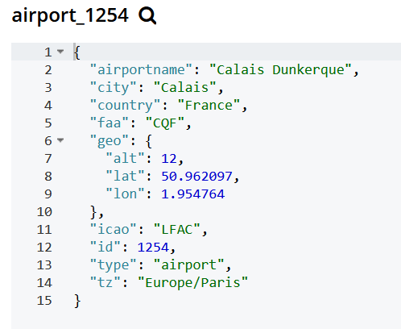
Document
Similar to Key-value
Difference is that, the value contains structure or semi-structured data
Value is called document and can be in JSON, XML, BSON formats
CouchDB, MongoDB etc.
Use cases:
Ecommerce platforms
Content management systems
Analytics platform
Blogging platform

Slide 10
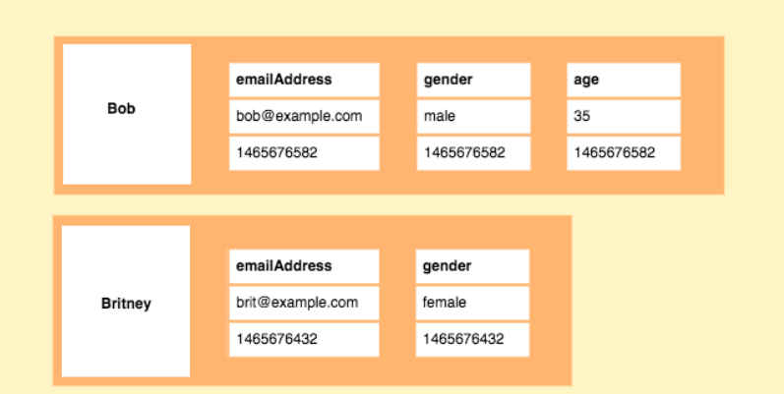
Column family
Data is stored in cells grouped in columns of data
Columns are logically grouped into column families
Column families are groups of similar data that is usually accessed together
Cassandra, Hbase etc.
Use cases:
Content management systems
Systems that maintains counters
Services having expiry usage
Systems requiring heavy write requests
Log aggregators

Slide 11
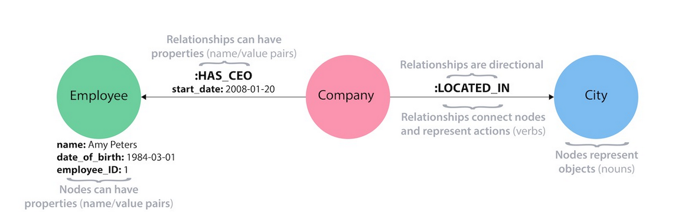
Graph
Store entities and relationship as node and edge of the graph
Entity contains the data and Relationship is how entity are interlinked
Relationship can be defined on-the-fly
Neo4j, OrientDB etc.
Use cases:
Social network application
Location based services
Network and IT operations
Fraud detection

Slide 12
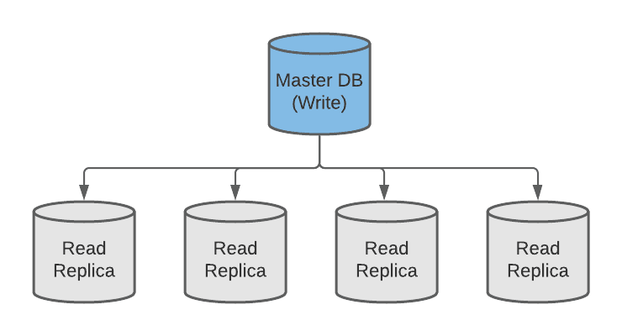
Replication
Replication copies data across multiple servers, so each bit of data can be found in multiple places.
Synchronous:
Perform write
Data got replicated to all nodes
Gets back success acknowledgement
Asynchronous:
Perform write
Gets back success acknowledgement
Data got replicated to all nodes in background

Slide 13
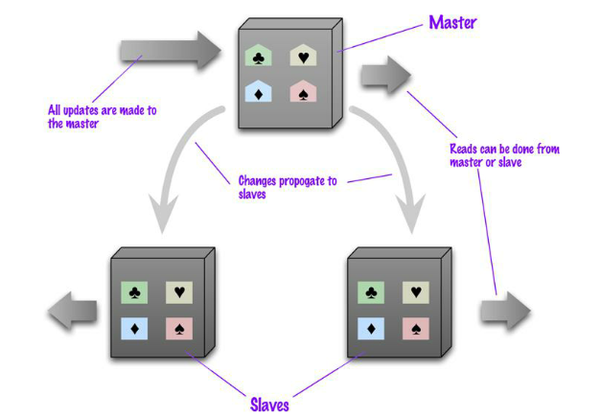
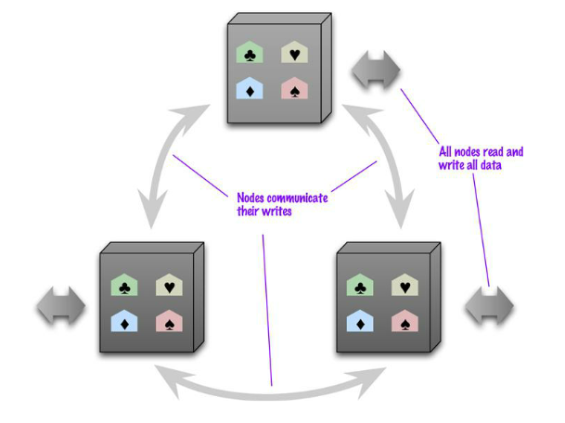
Type of replication
Master-Slave:
One node is in-charge
Write happens on master and propagates to slave nodes where read happens
Good for read-intensive services
Single point of failure
Peer-to-Peer:
All nodes are equal
Write-read can happen on any node
Can easily withstand node failure
Write conflicts can be the issue

Slide 14
Sharding
Sharding distributes different data across multiple servers, so each server acts as the single source for a subset of data.
Logical Shards
Advantages:
Increased Read/Write Throughput
Increased storage capacity
High availability
Disadvantages:
Query overhead
Poor shard key causes hotspots
Increased Infrastructure Costs
Shards
Server 1
Node1
Node2
DB
Physical Shards
Server 2
Node3
Node4

Slide 15
Sharding Techniques
Algorithmic sharding:
Algorithm takes data and decides the shard it belongs
e.g. Hash Value=ID % Number of Shards
Increasing no of shards will require rebalance
Dynamic sharding:
Lookup service is maintained for the data and shard mapping
e.g. Geography based sharding
Lookup tables should be chosen wisely so that it doesn’t grow very large
Lookup service can be single point failure or bottleneck

Slide 16
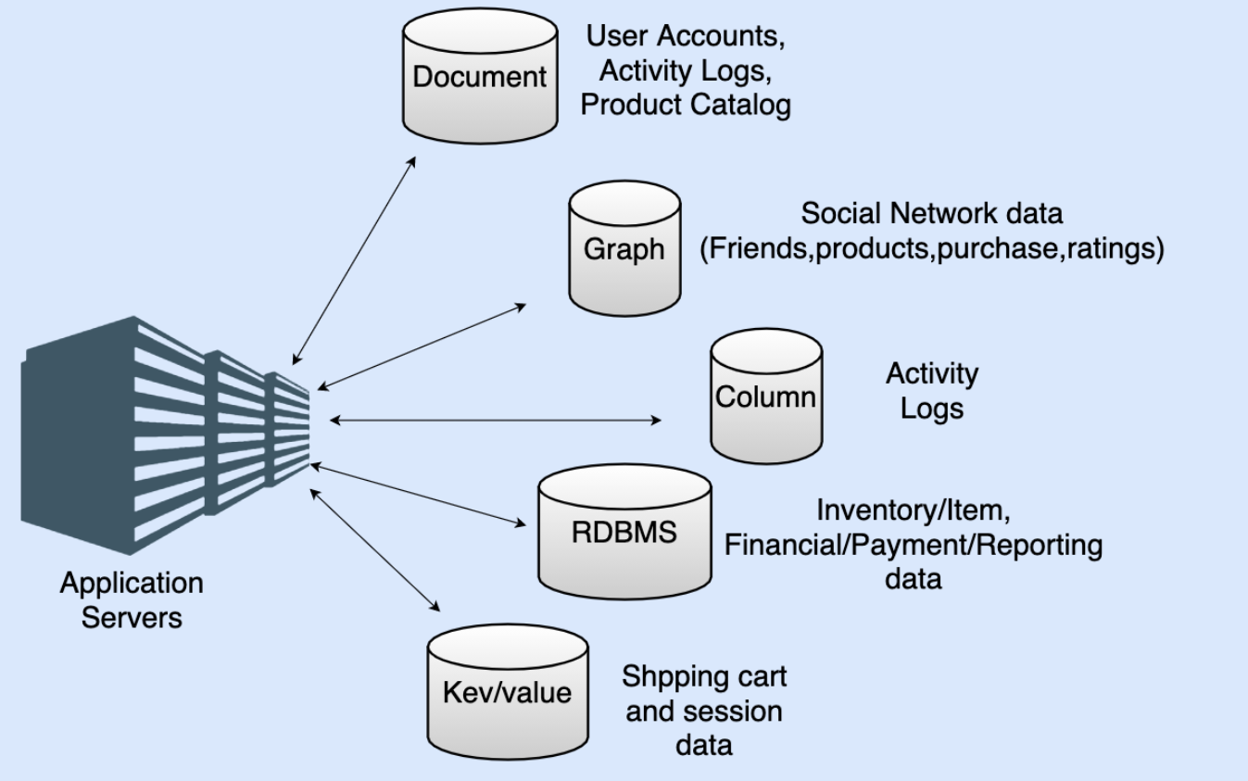
Polyglot persistence
Modern database solution for distributed systems are a combination of SQL and NoSQL solutions
Modern applications leverage the ACID properties of RDBMS where consistency is key
NoSQL is used for high availability data that gets the most hits
A single application can interact with both SQL and NoSQL databases and also different kinds of NoSQL databases at a time.

Slide 17
Questions?
Thank you!

